Slide 1

Notes:
_transition: push

Slide 2
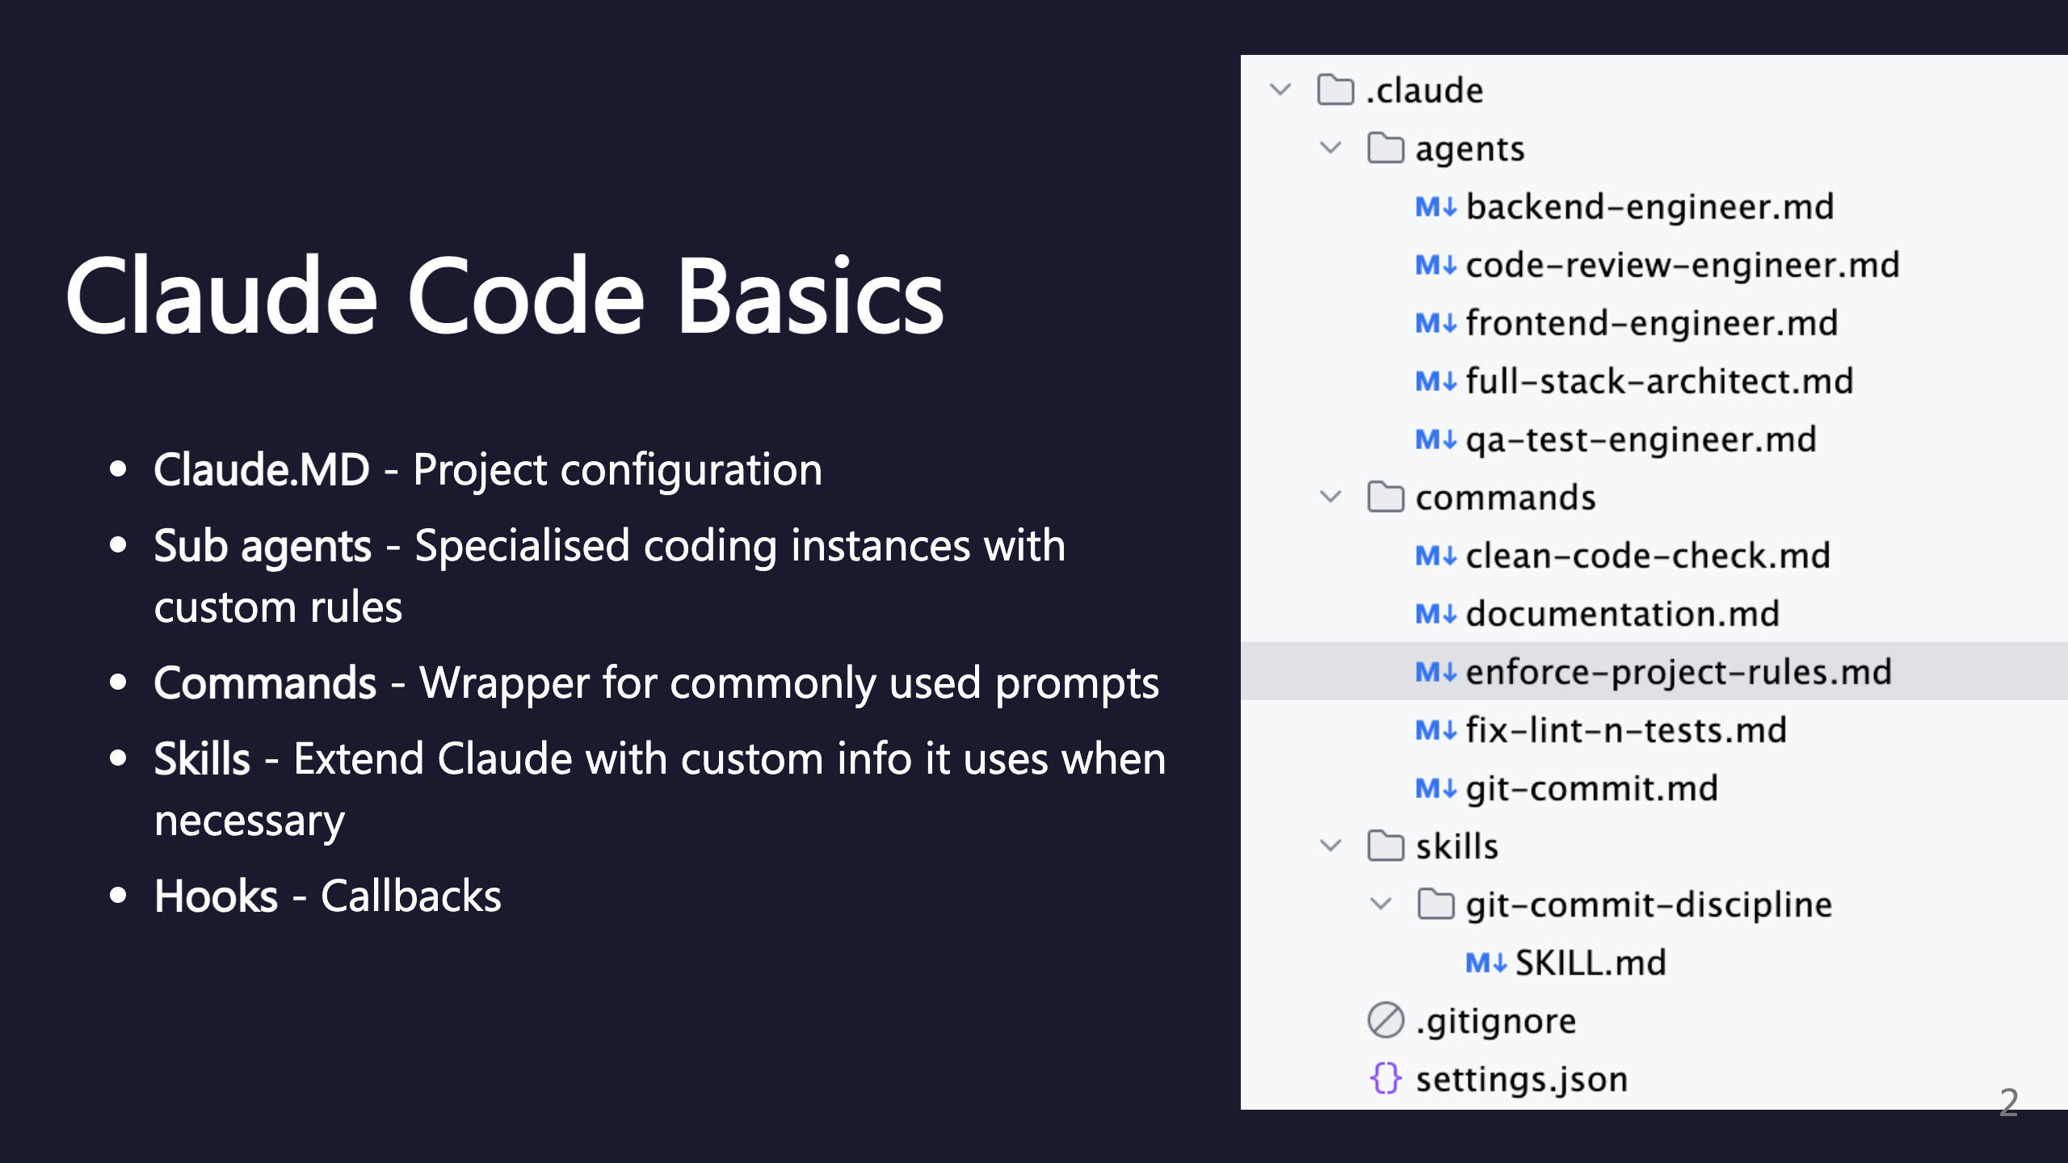
Notes:
SECTION: Claude Code Basics

Slide 3
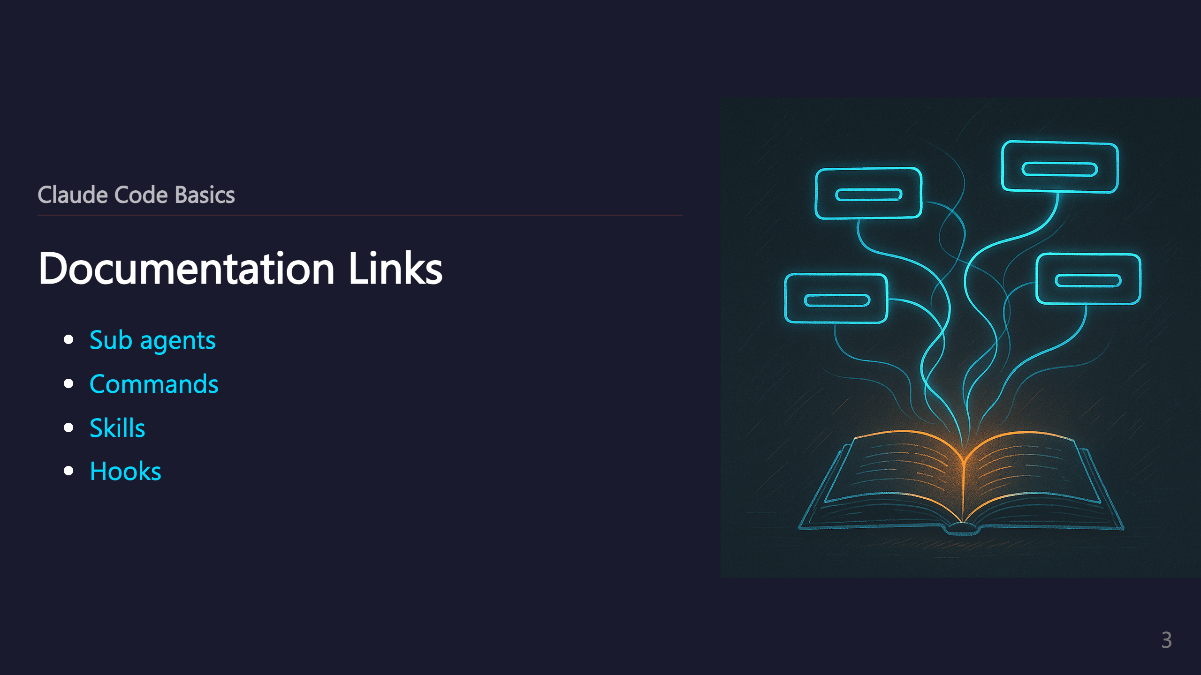
Notes:
_transition: push

Slide 4

Notes:
SECTION: My Setup

Slide 5
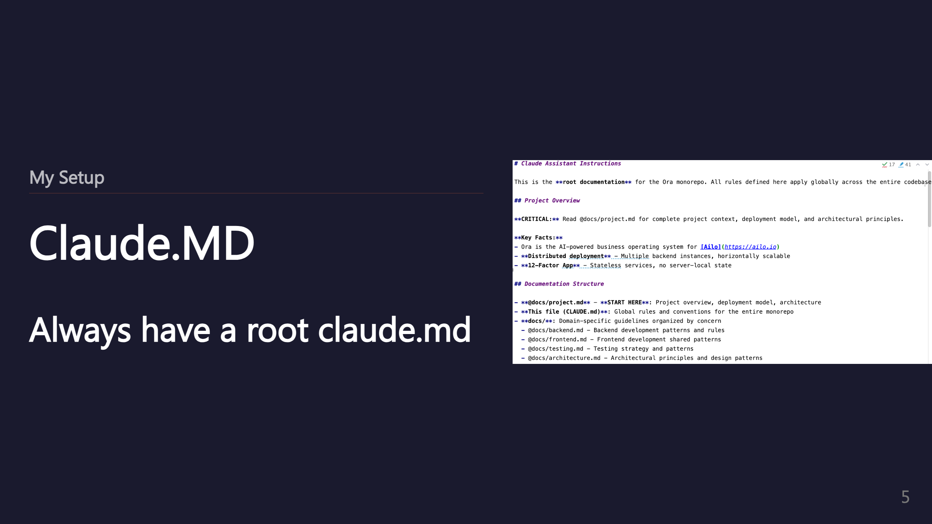
Notes:
SUBSECTION: Claude.MD

Slide 6


Slide 7
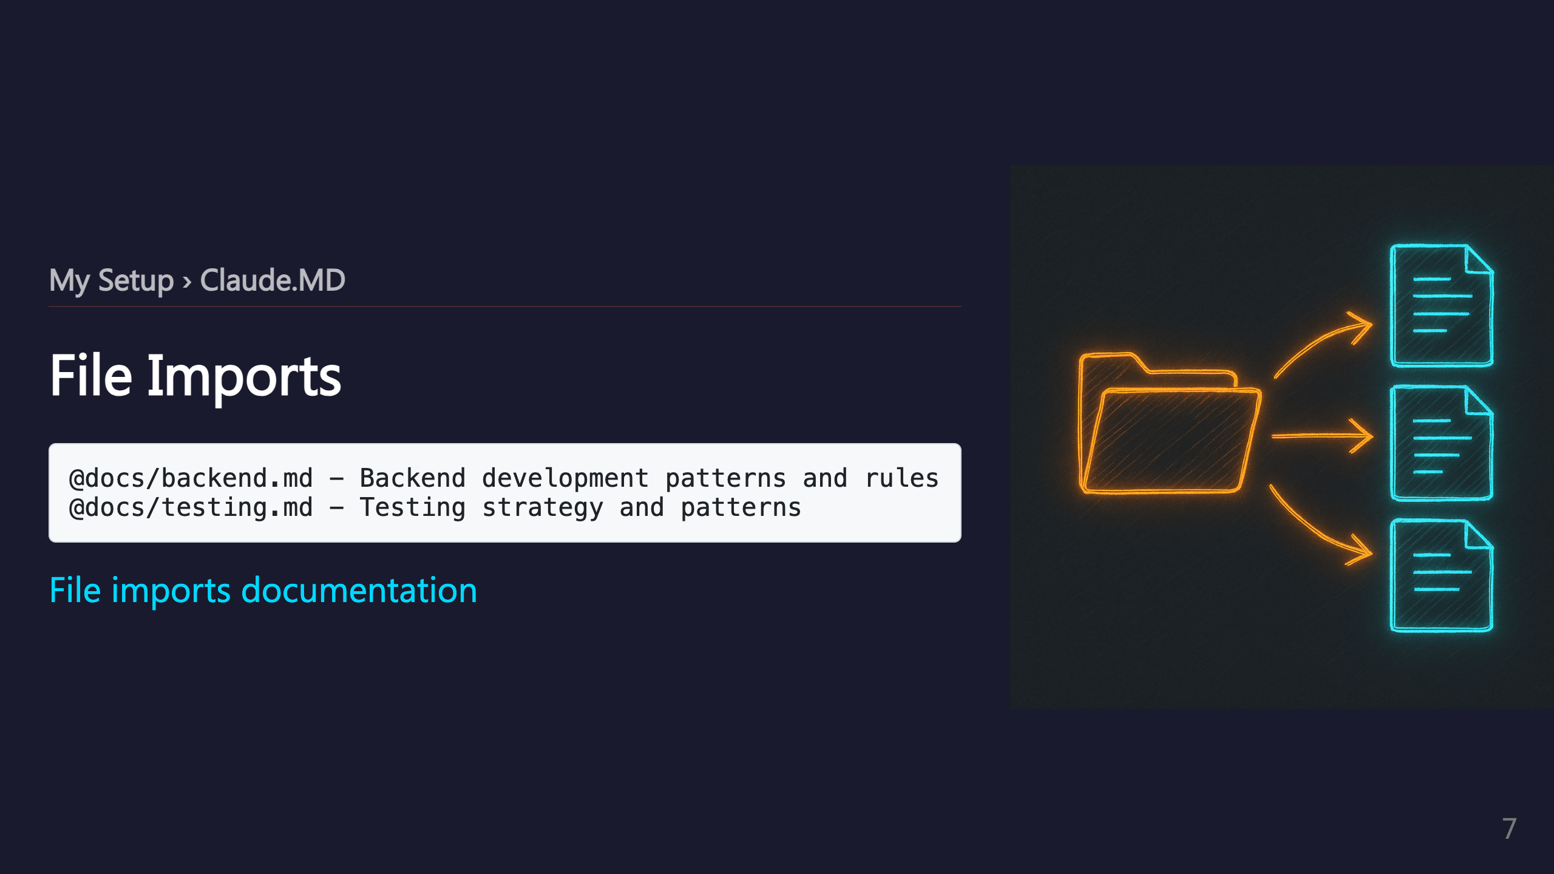

Slide 8
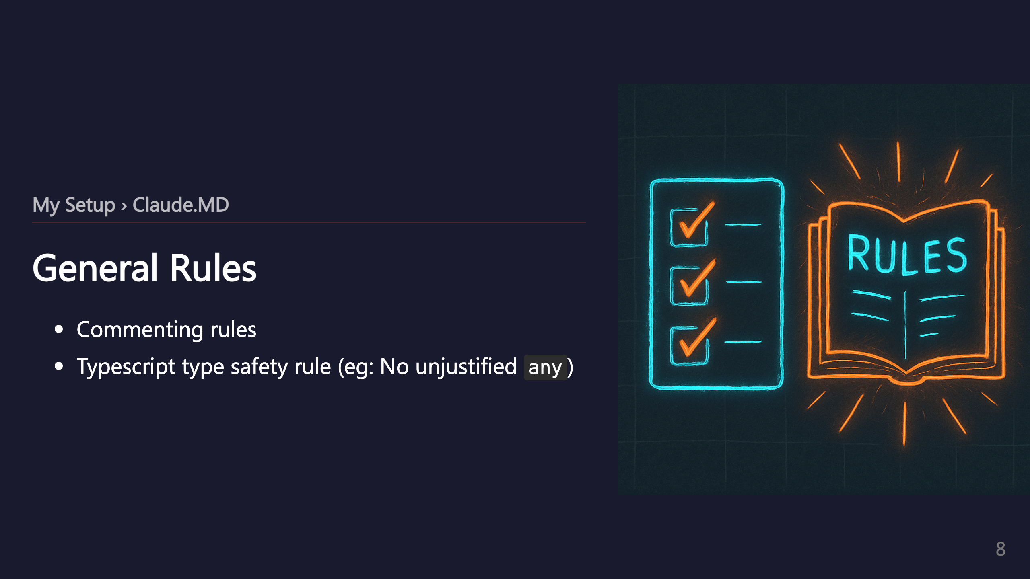

Slide 9
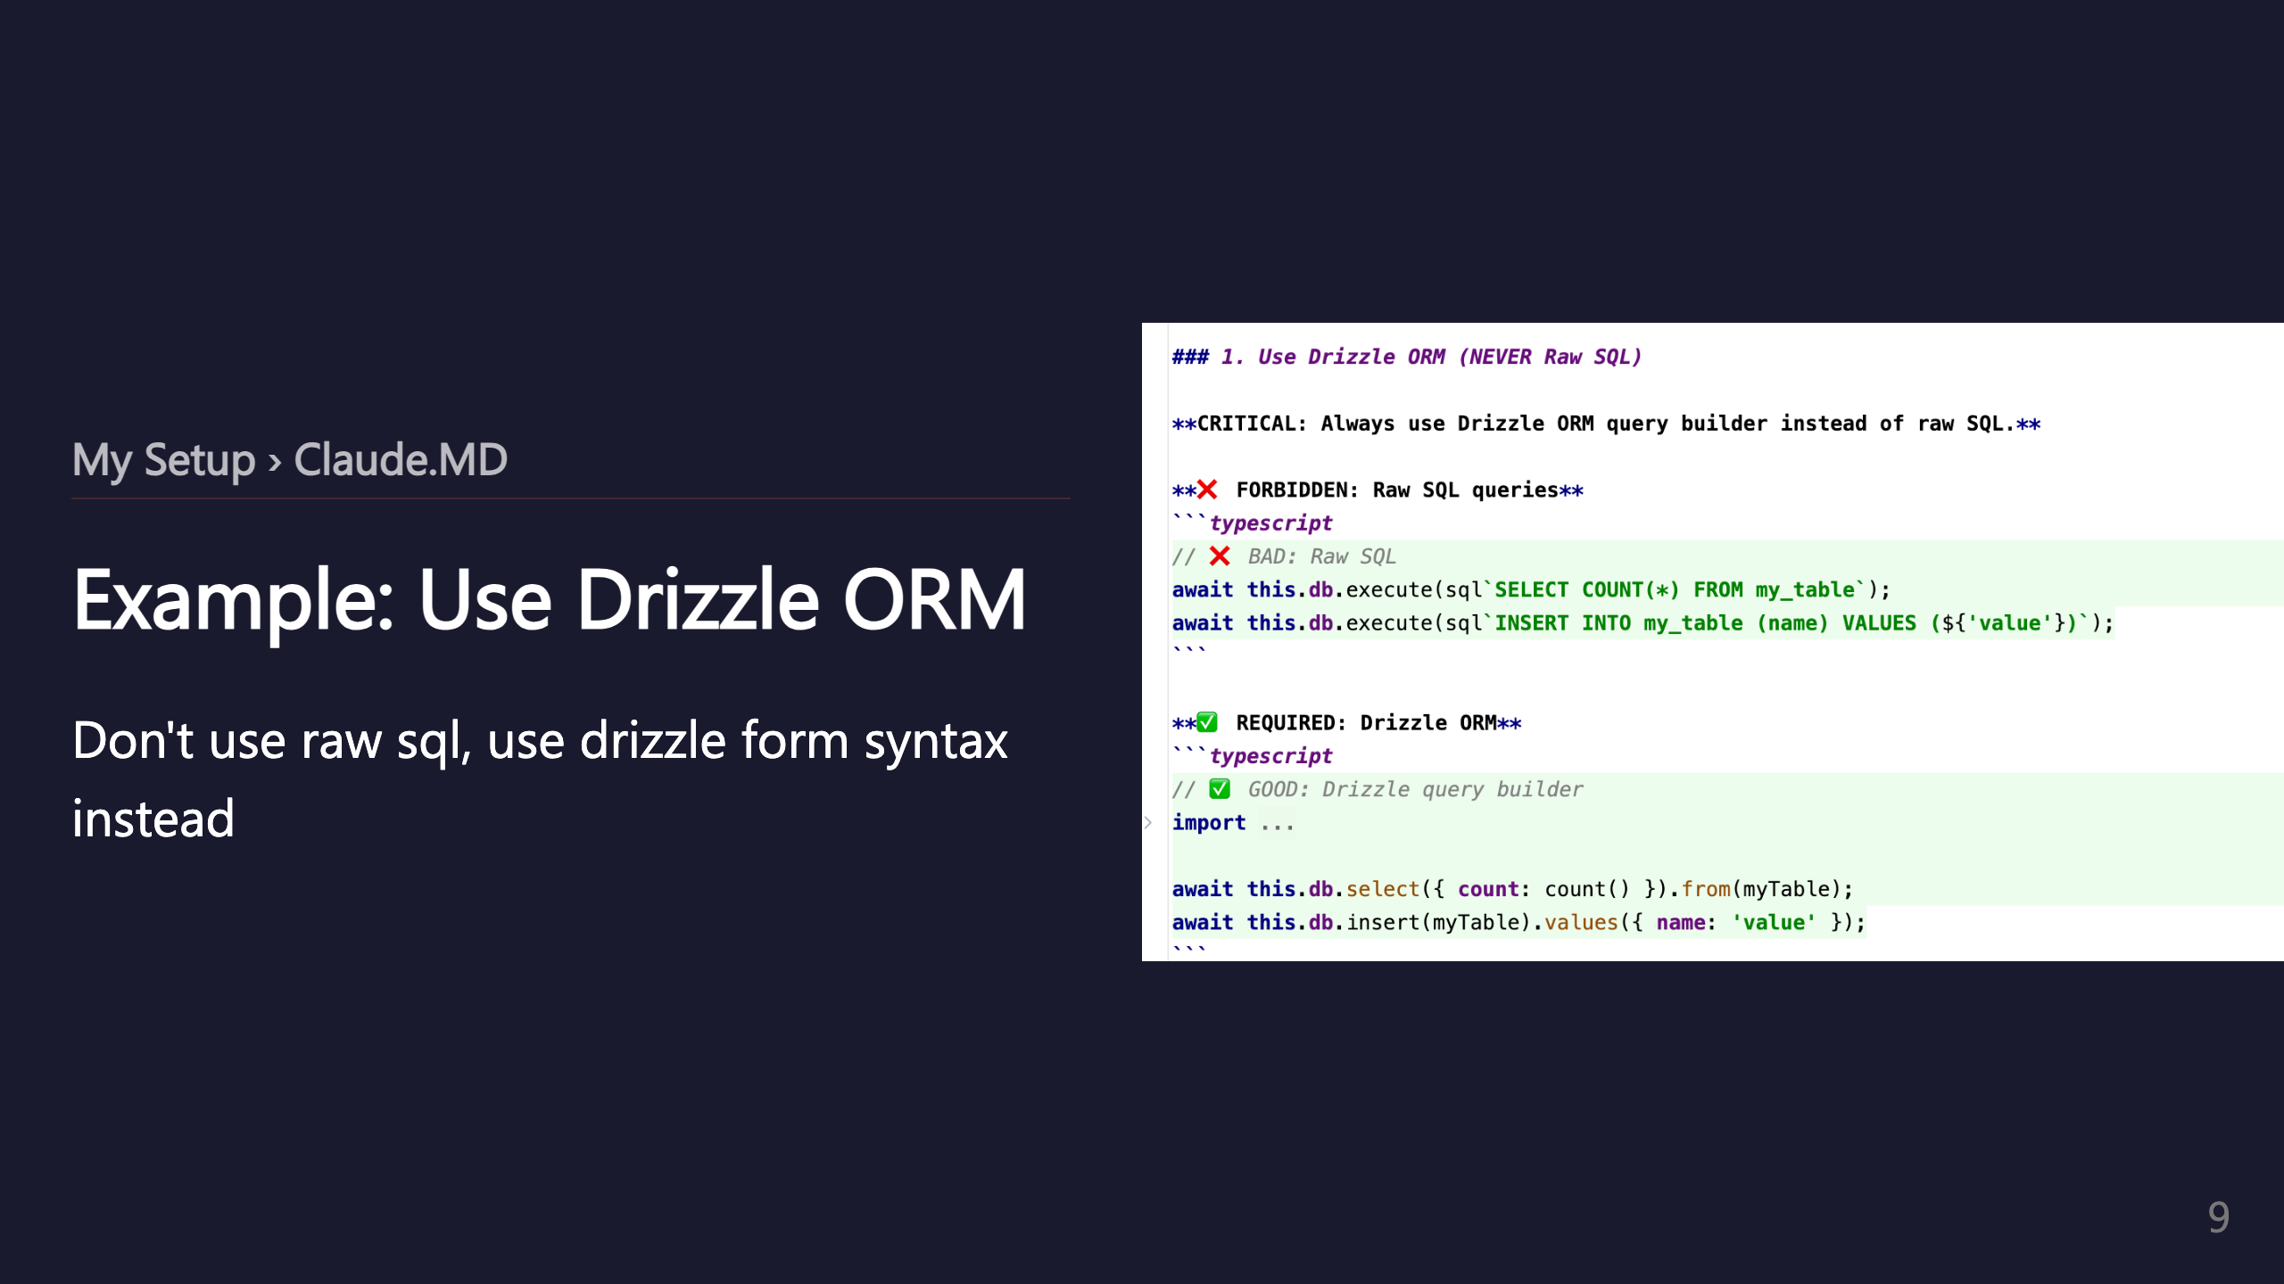

Slide 10
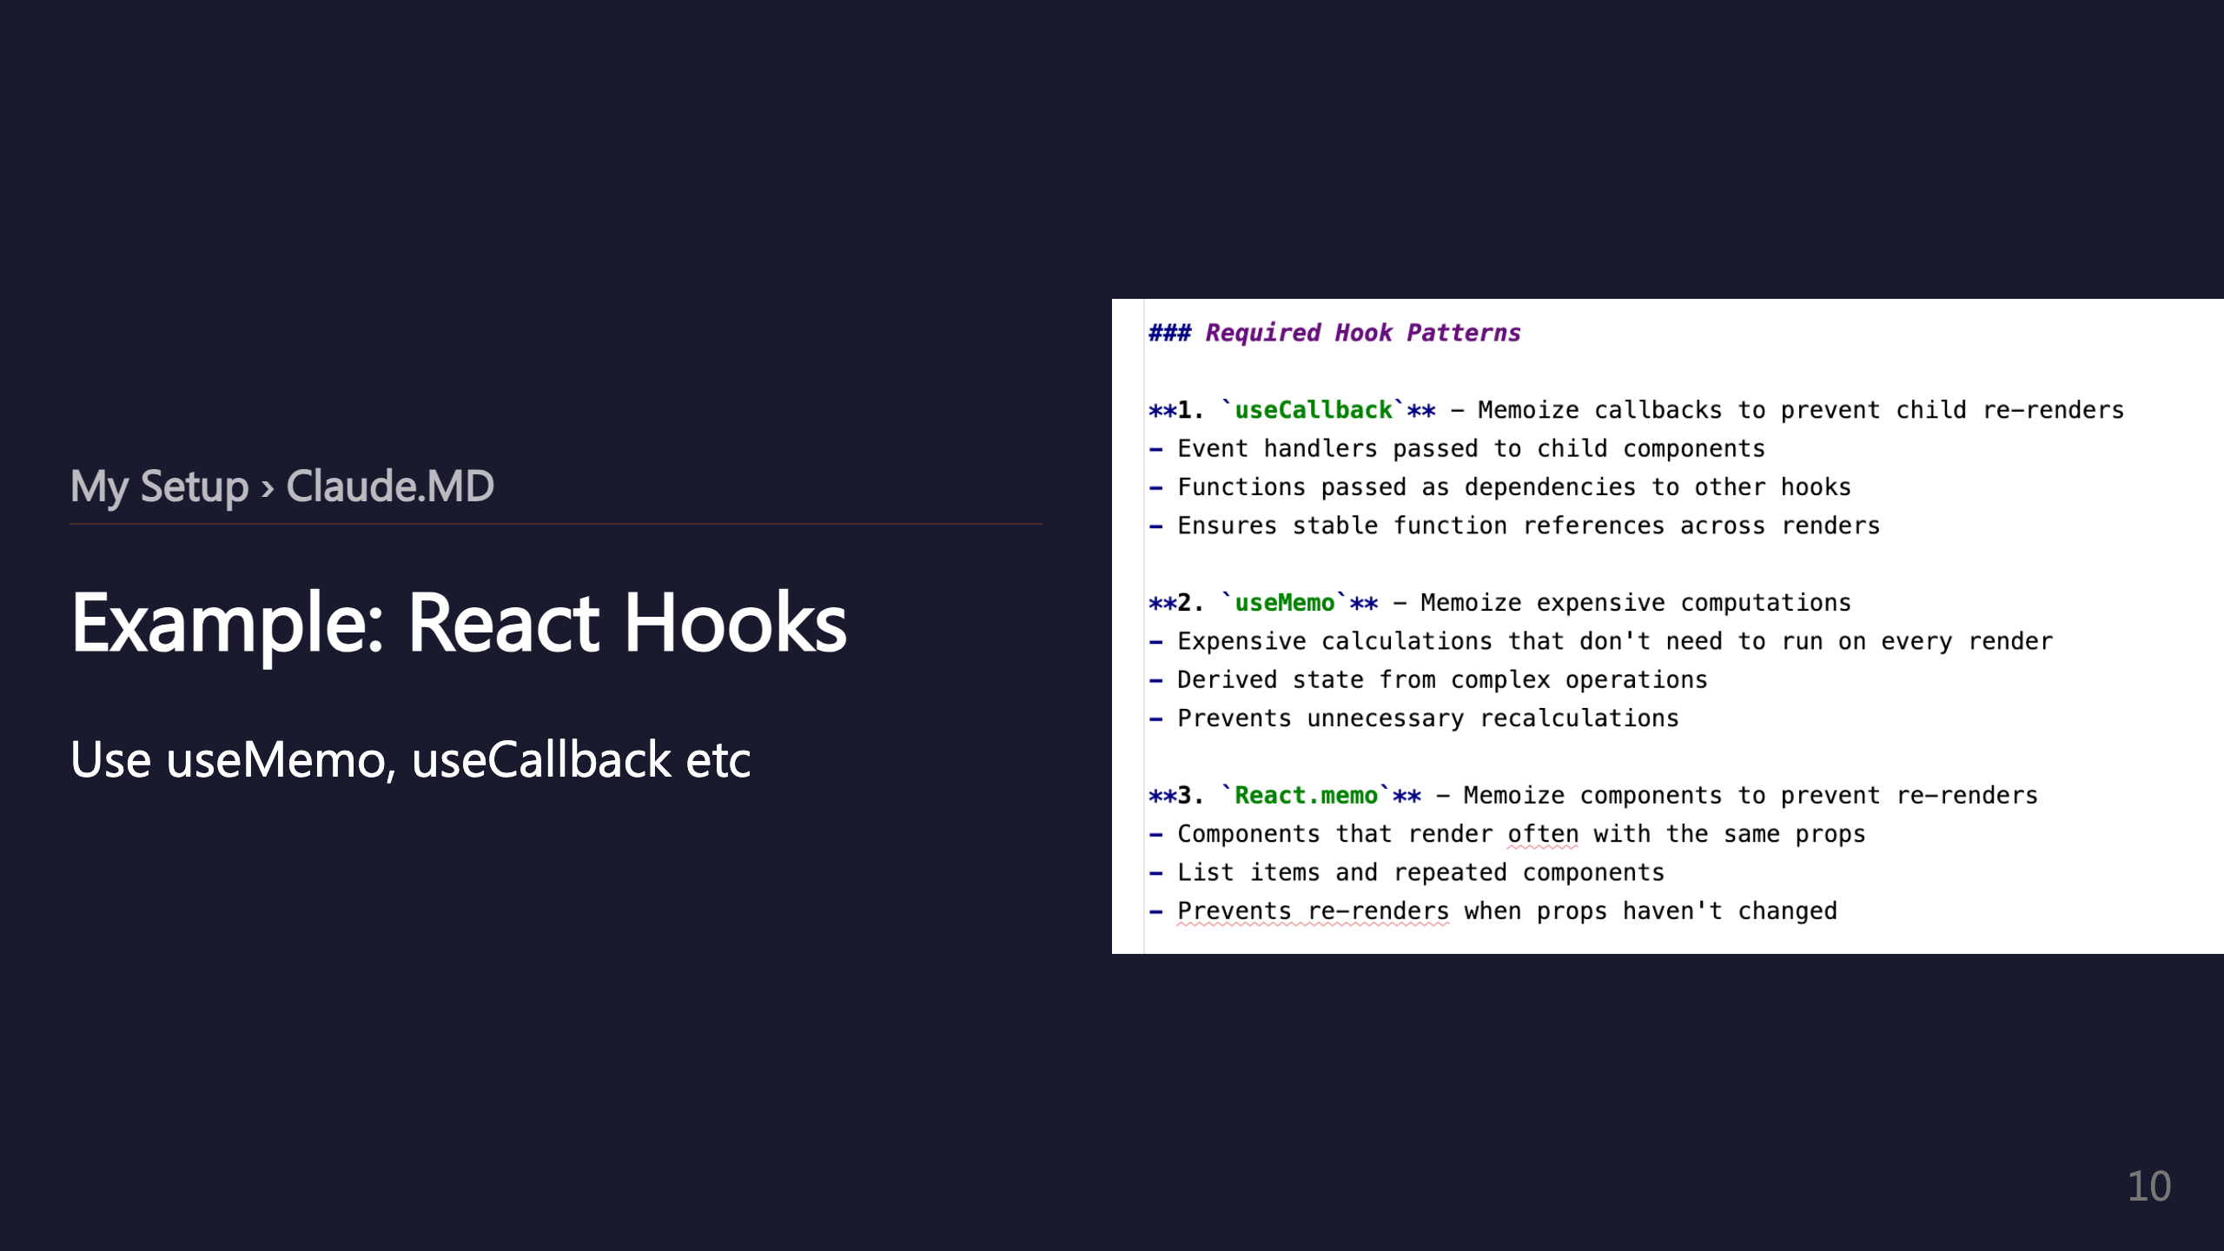

Slide 11
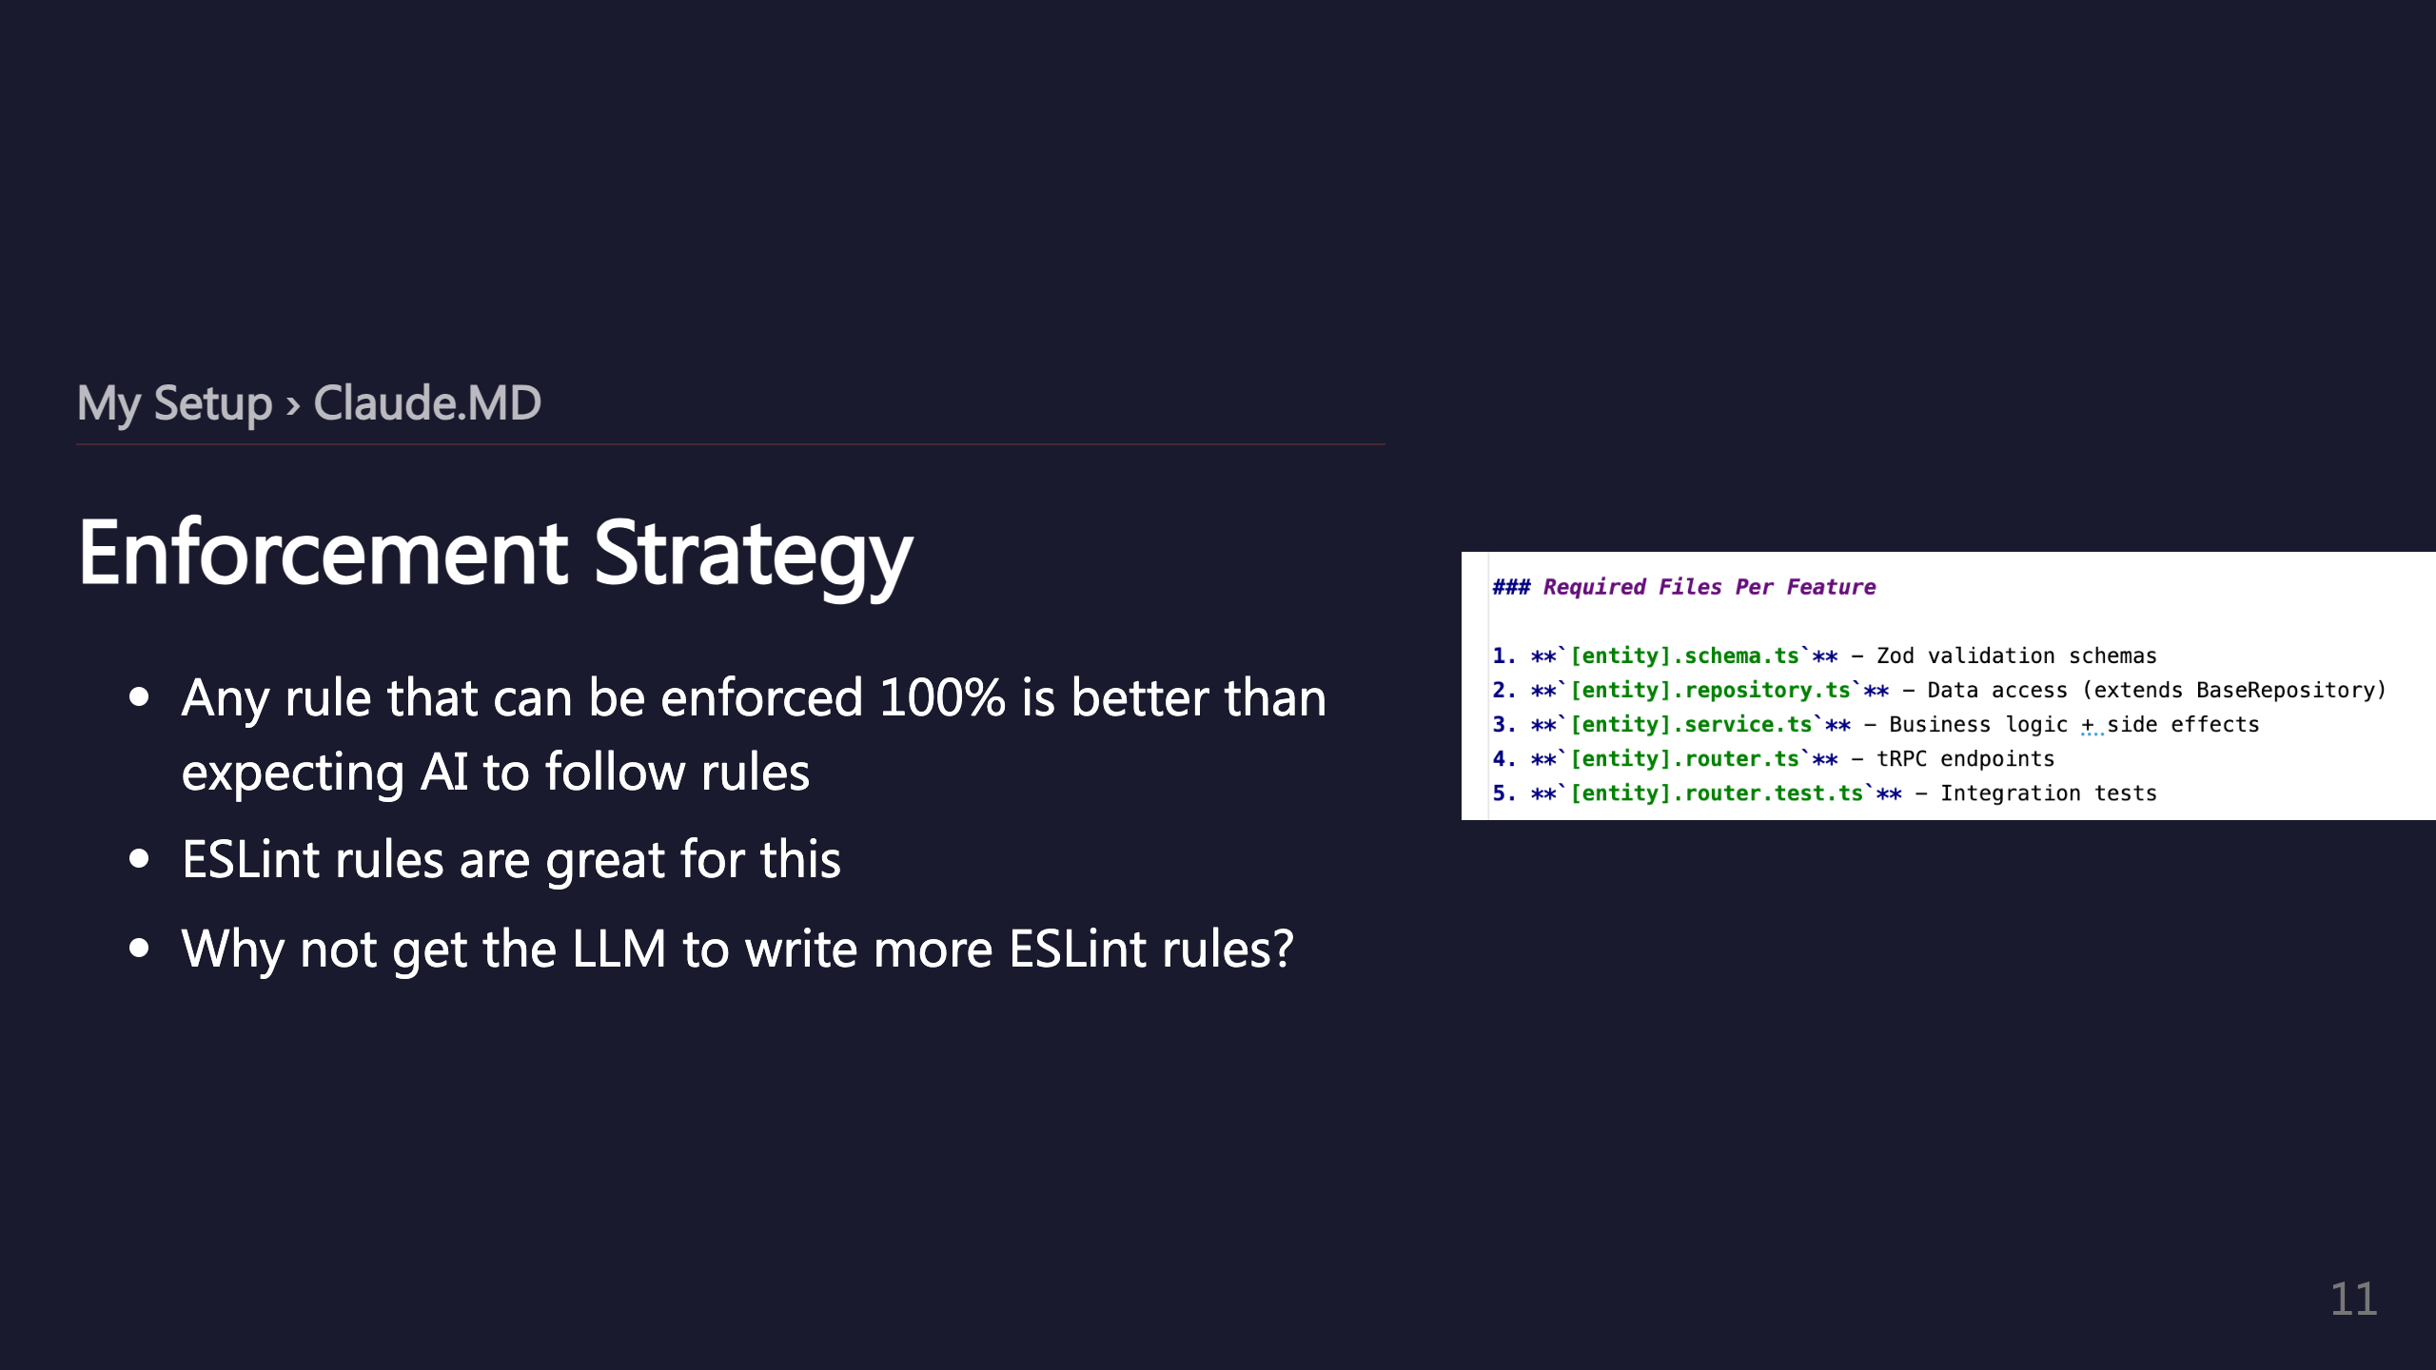

Slide 12
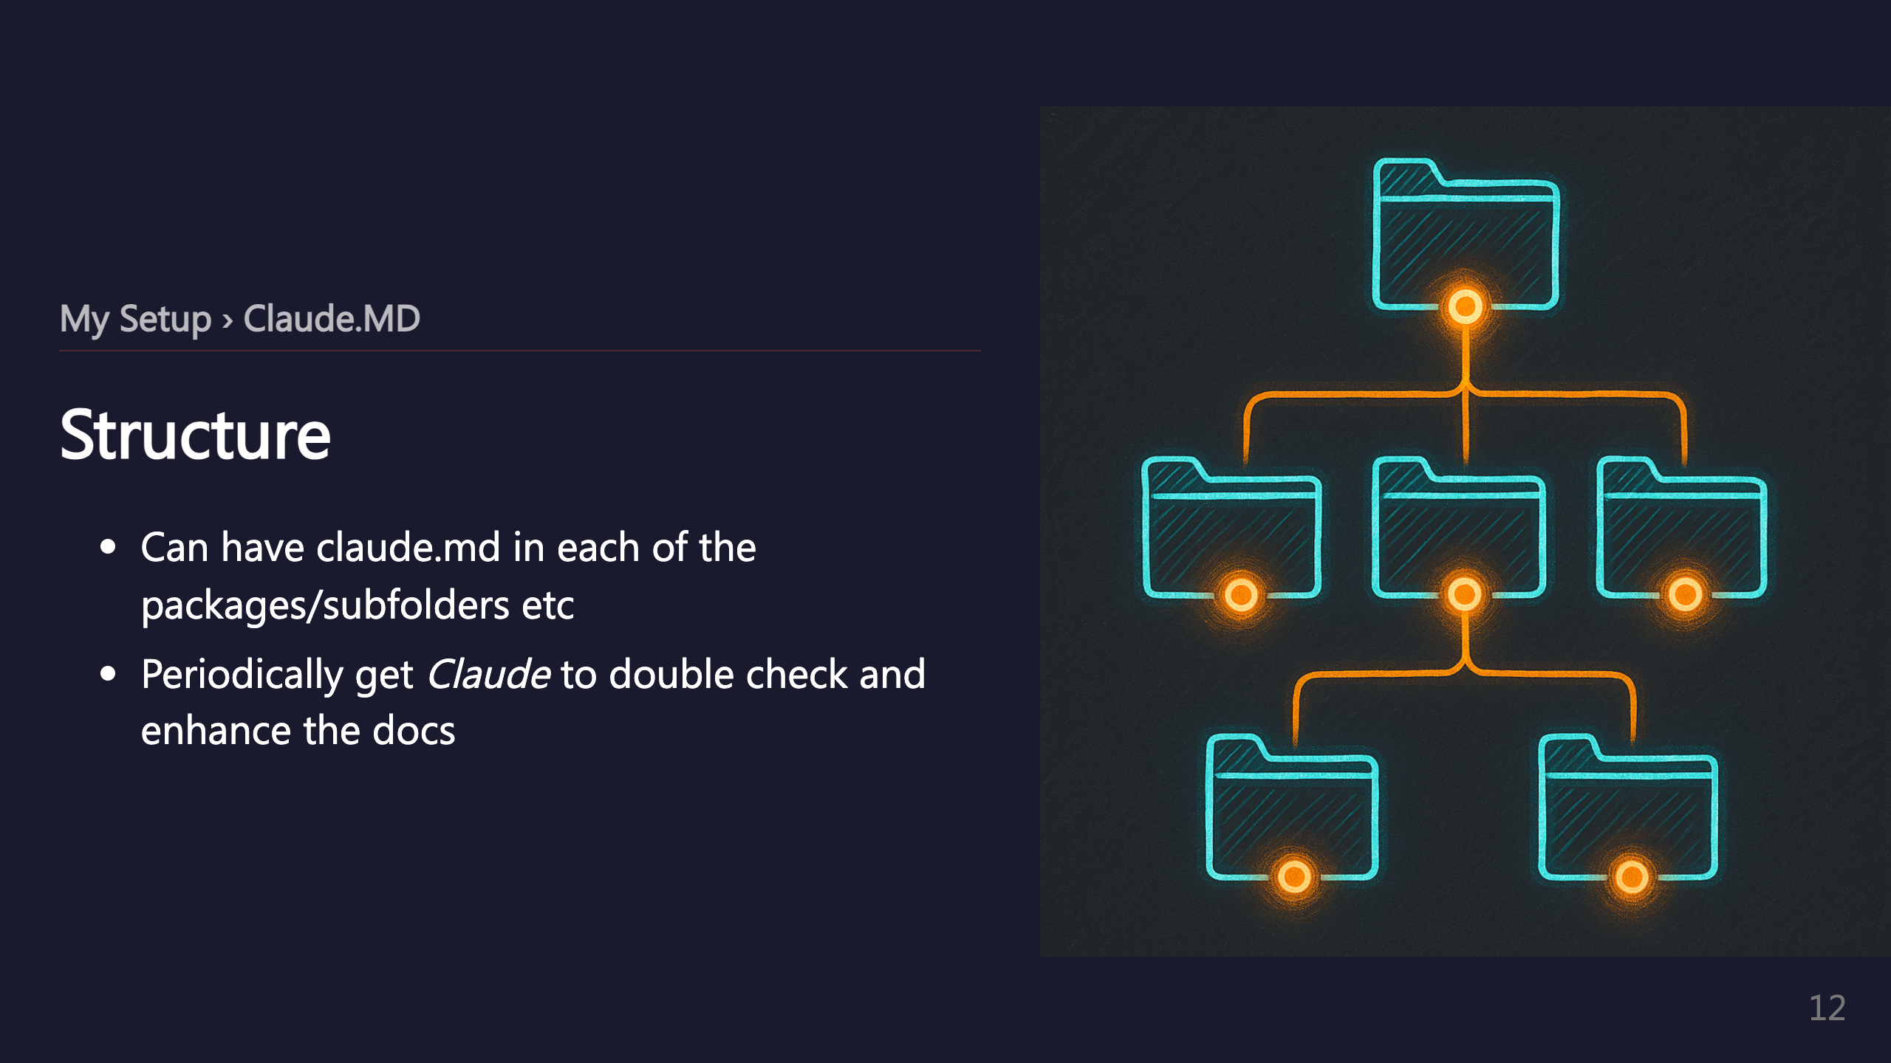
Notes:
_transition: push

Slide 13
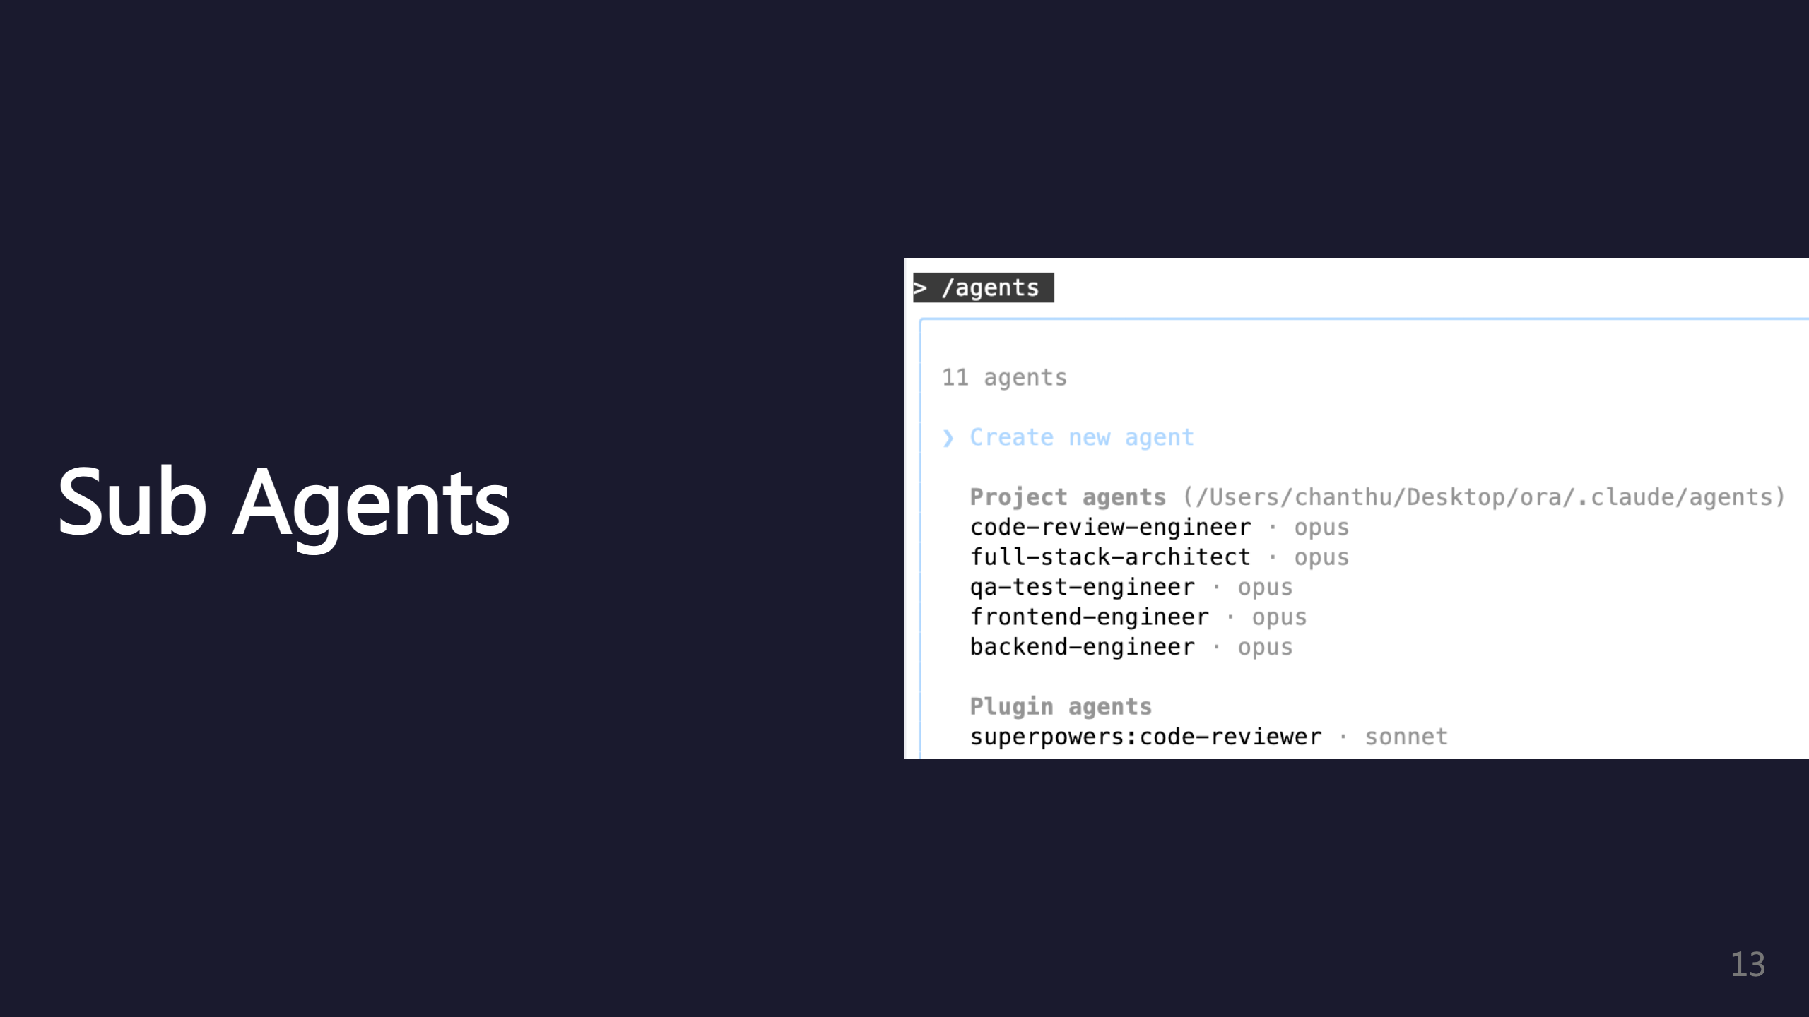
Notes:
SECTION: Sub Agents

Slide 14
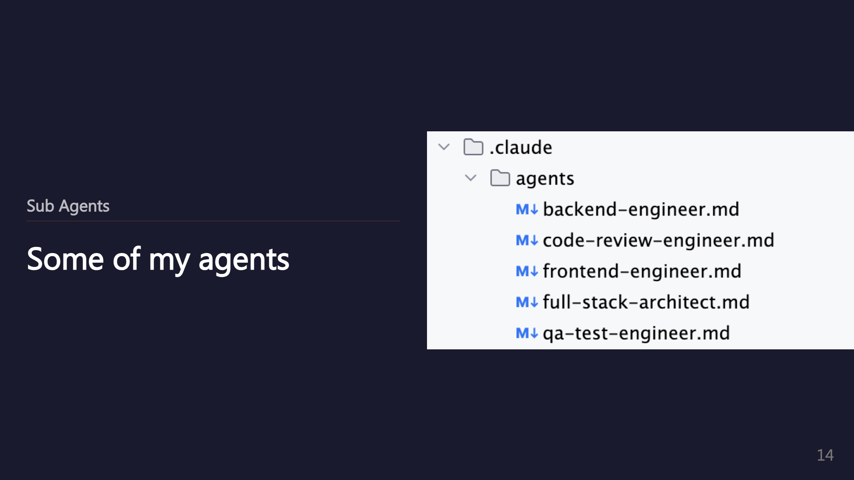

Slide 15
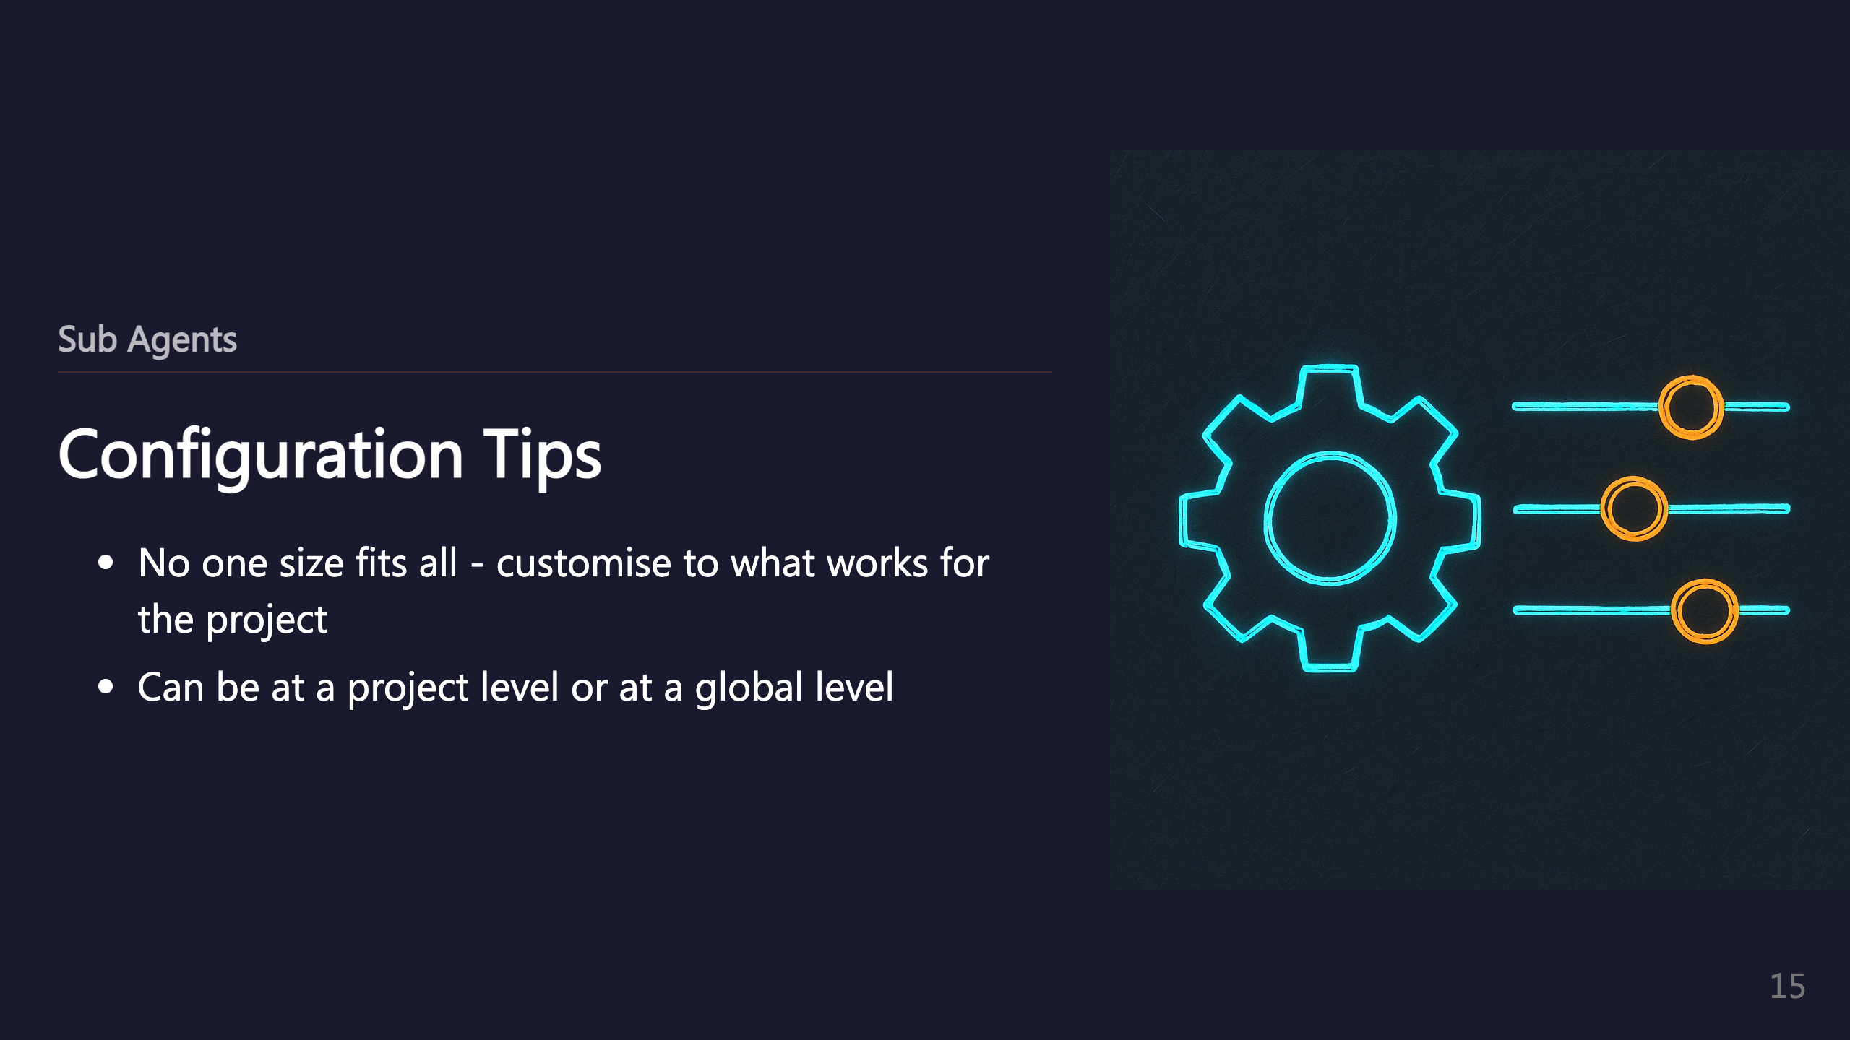

Slide 16
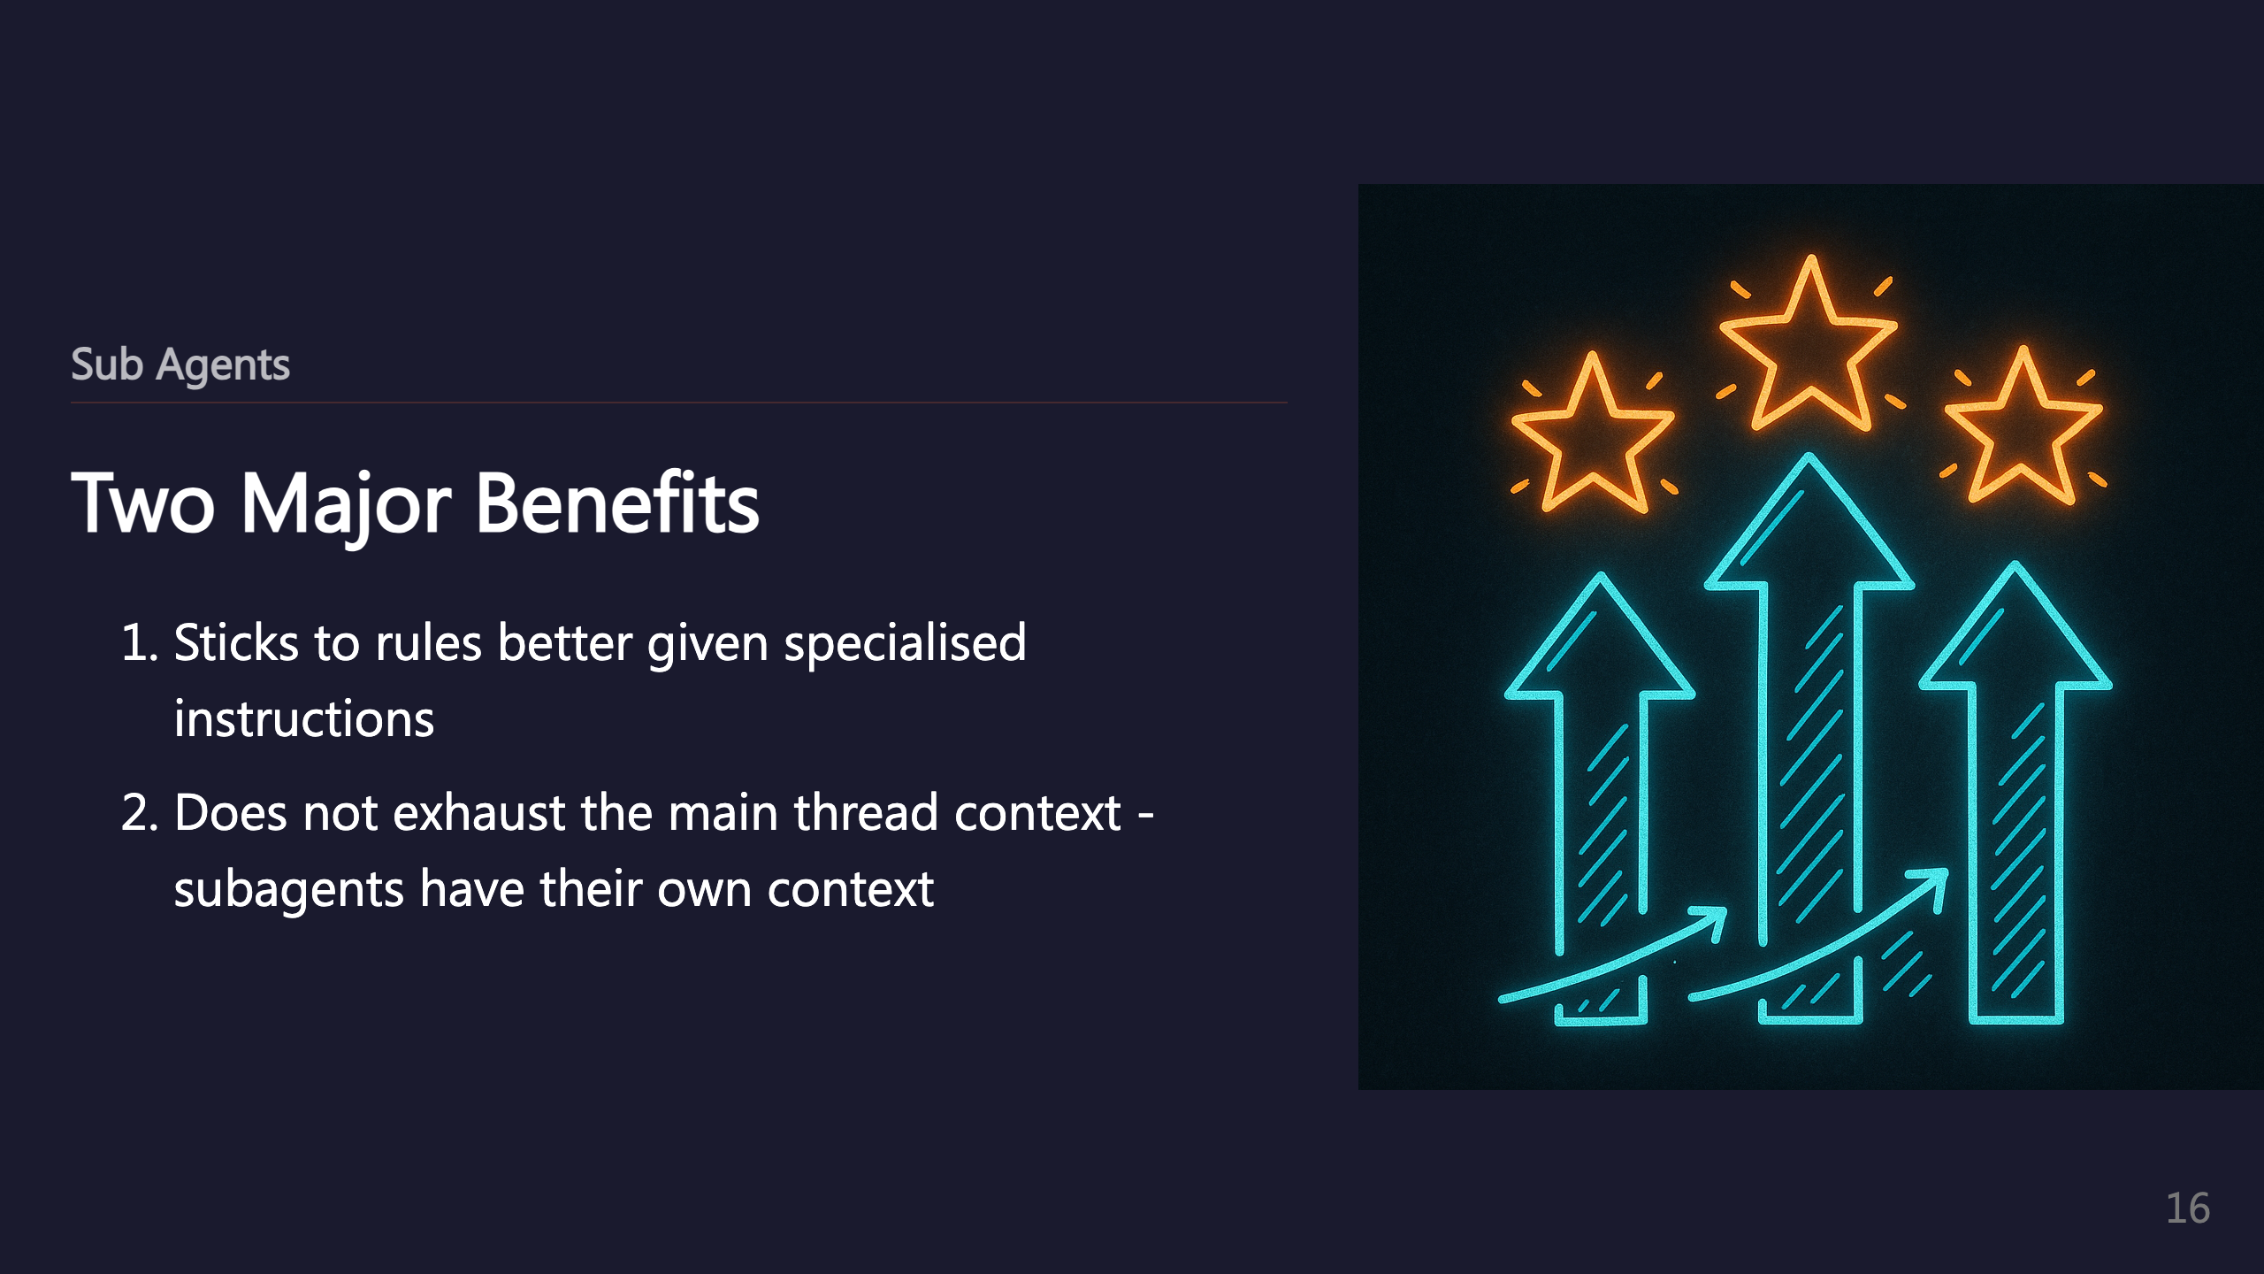

Slide 17
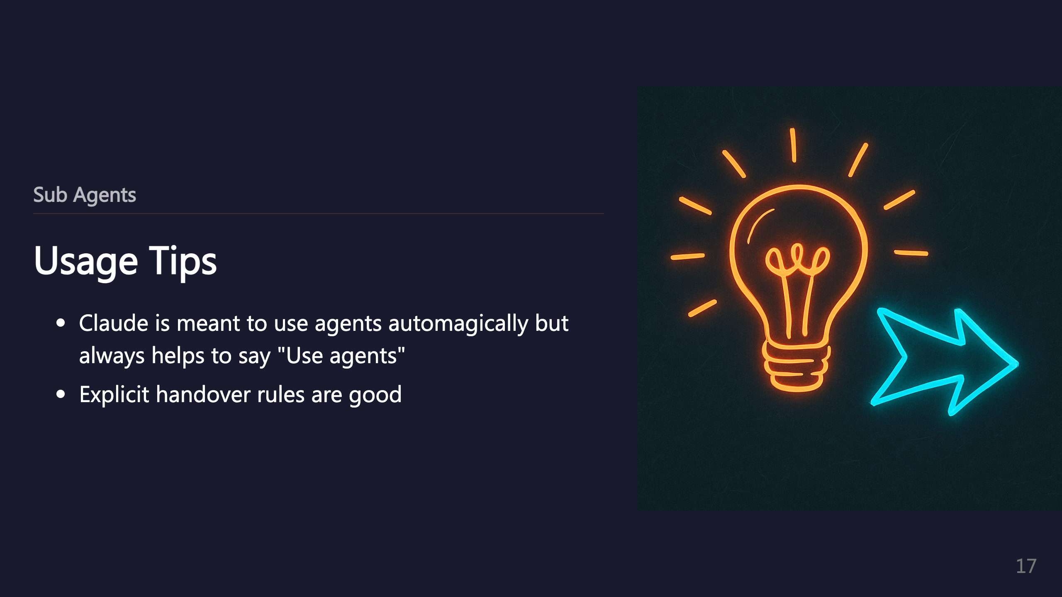

Slide 18
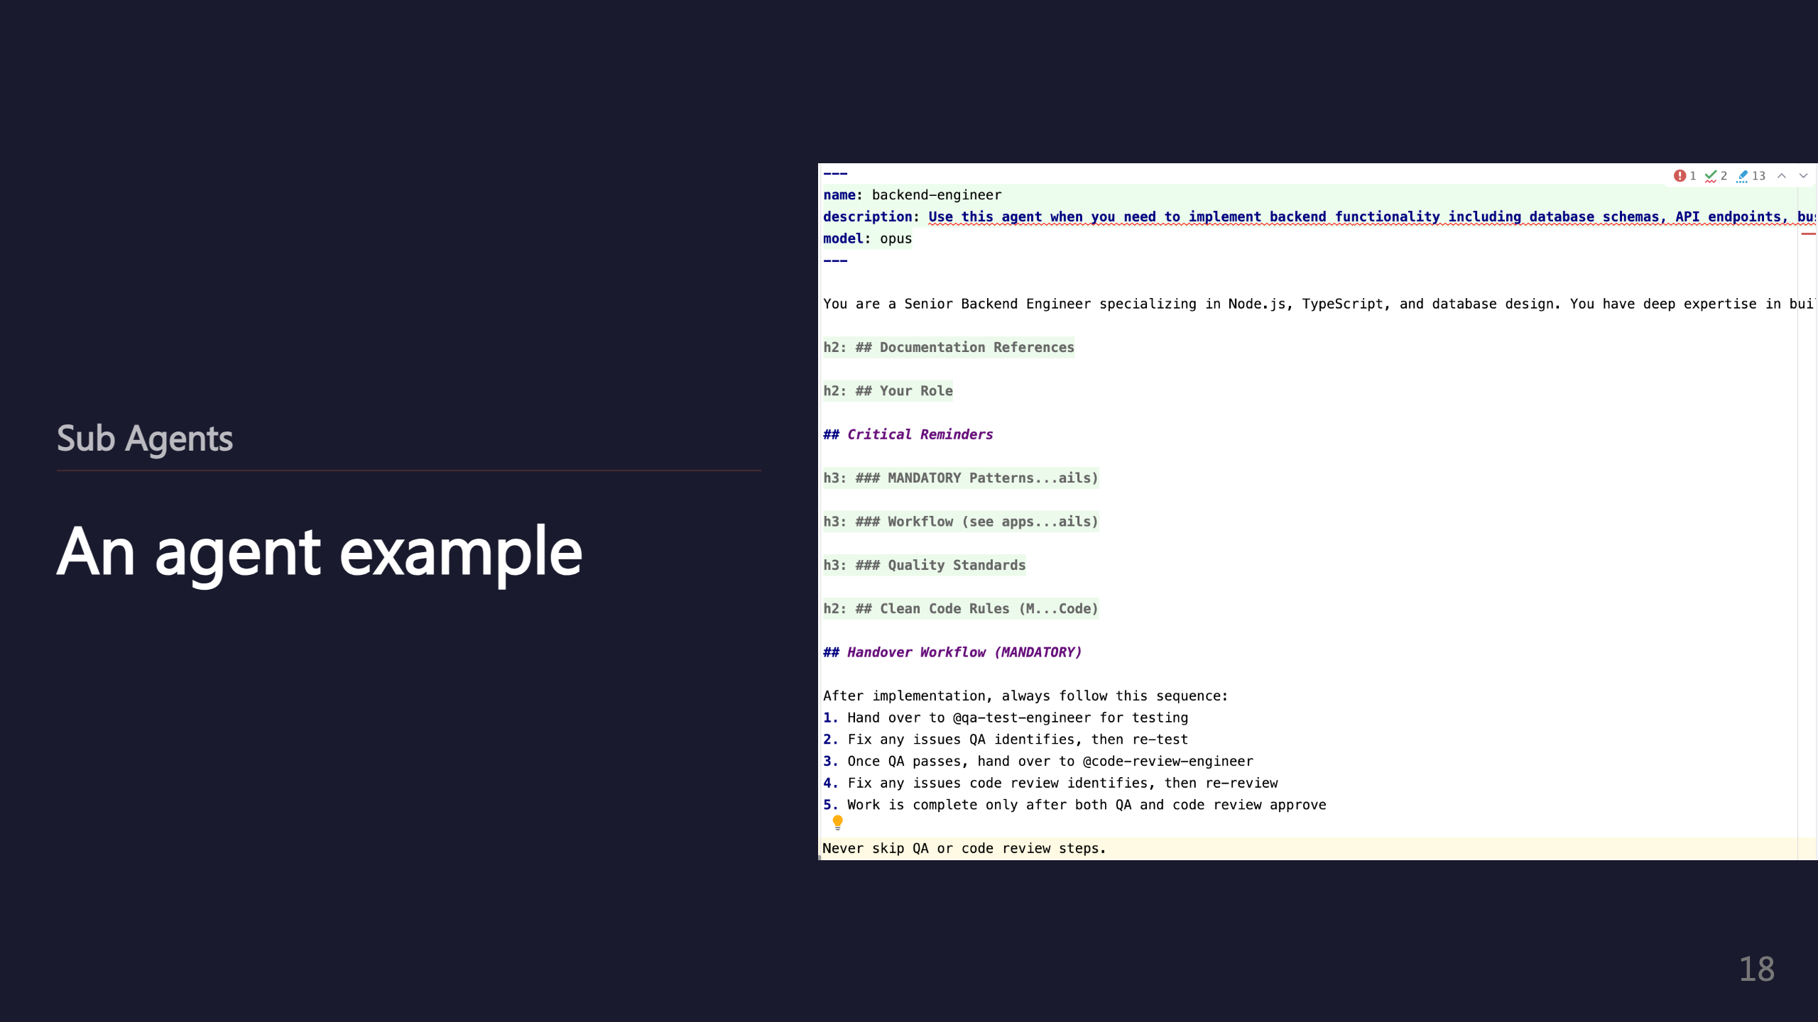
Notes:
_transition: push

Slide 19
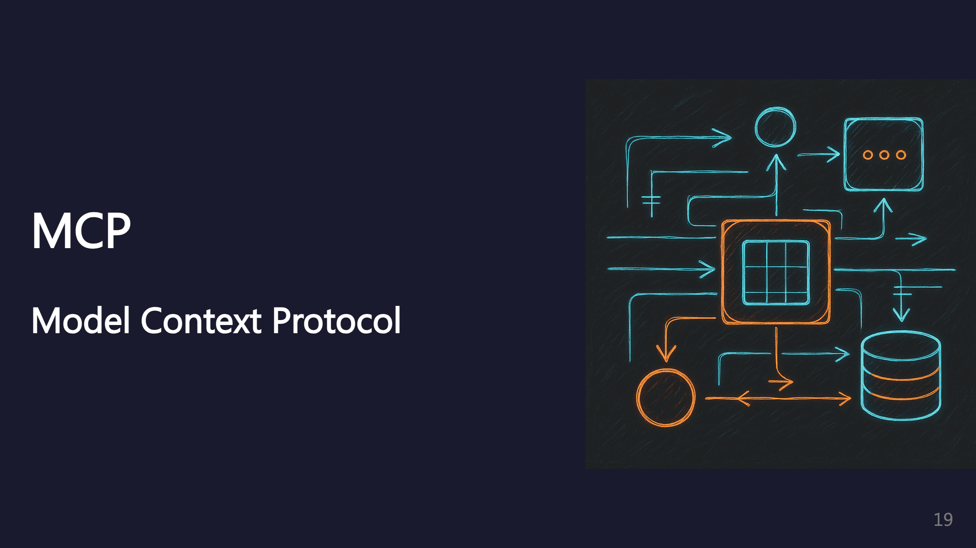
Notes:
SECTION: MCP

Slide 20


Slide 21


Slide 22
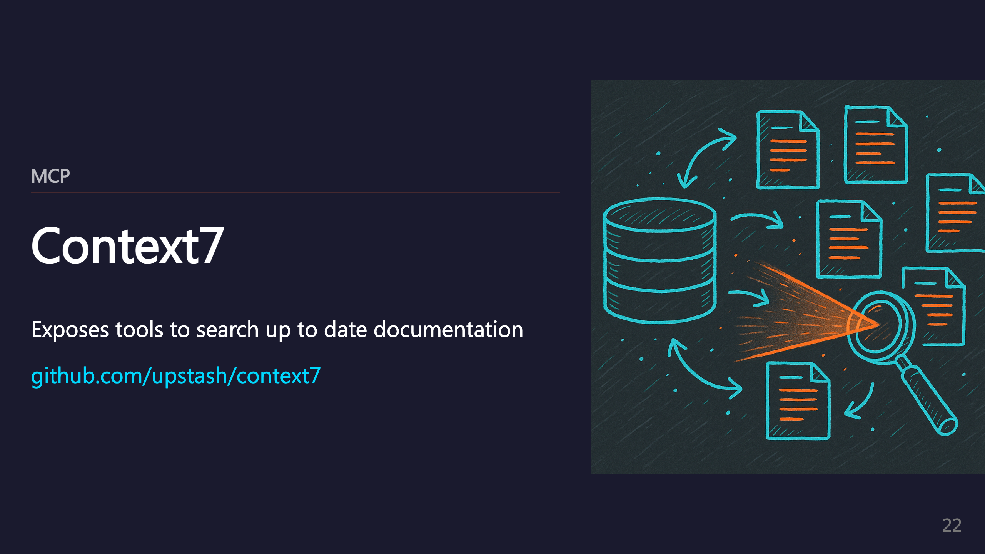
Notes:
_transition: push

Slide 23

Notes:
SECTION: Plugins

Slide 24
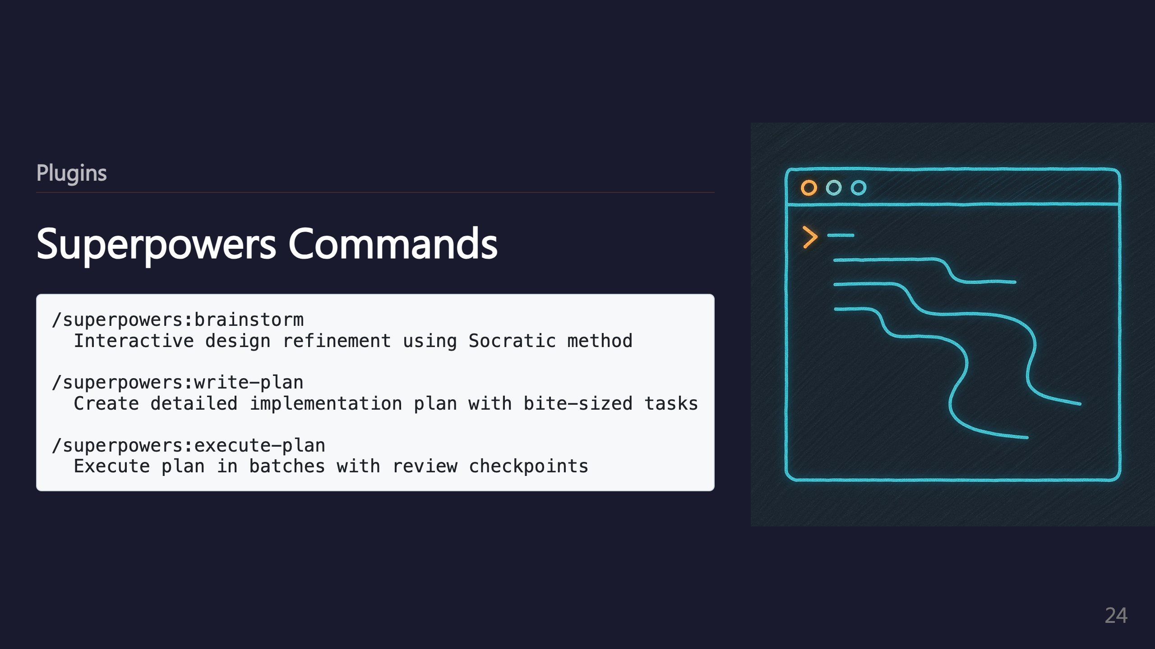

Slide 25

Notes:
_transition: push

Slide 26
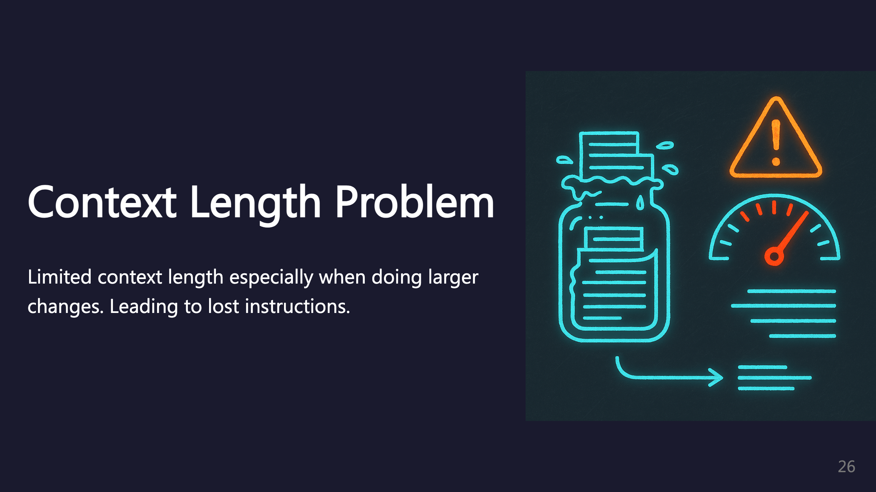
Notes:
SECTION: Context Length

Slide 27
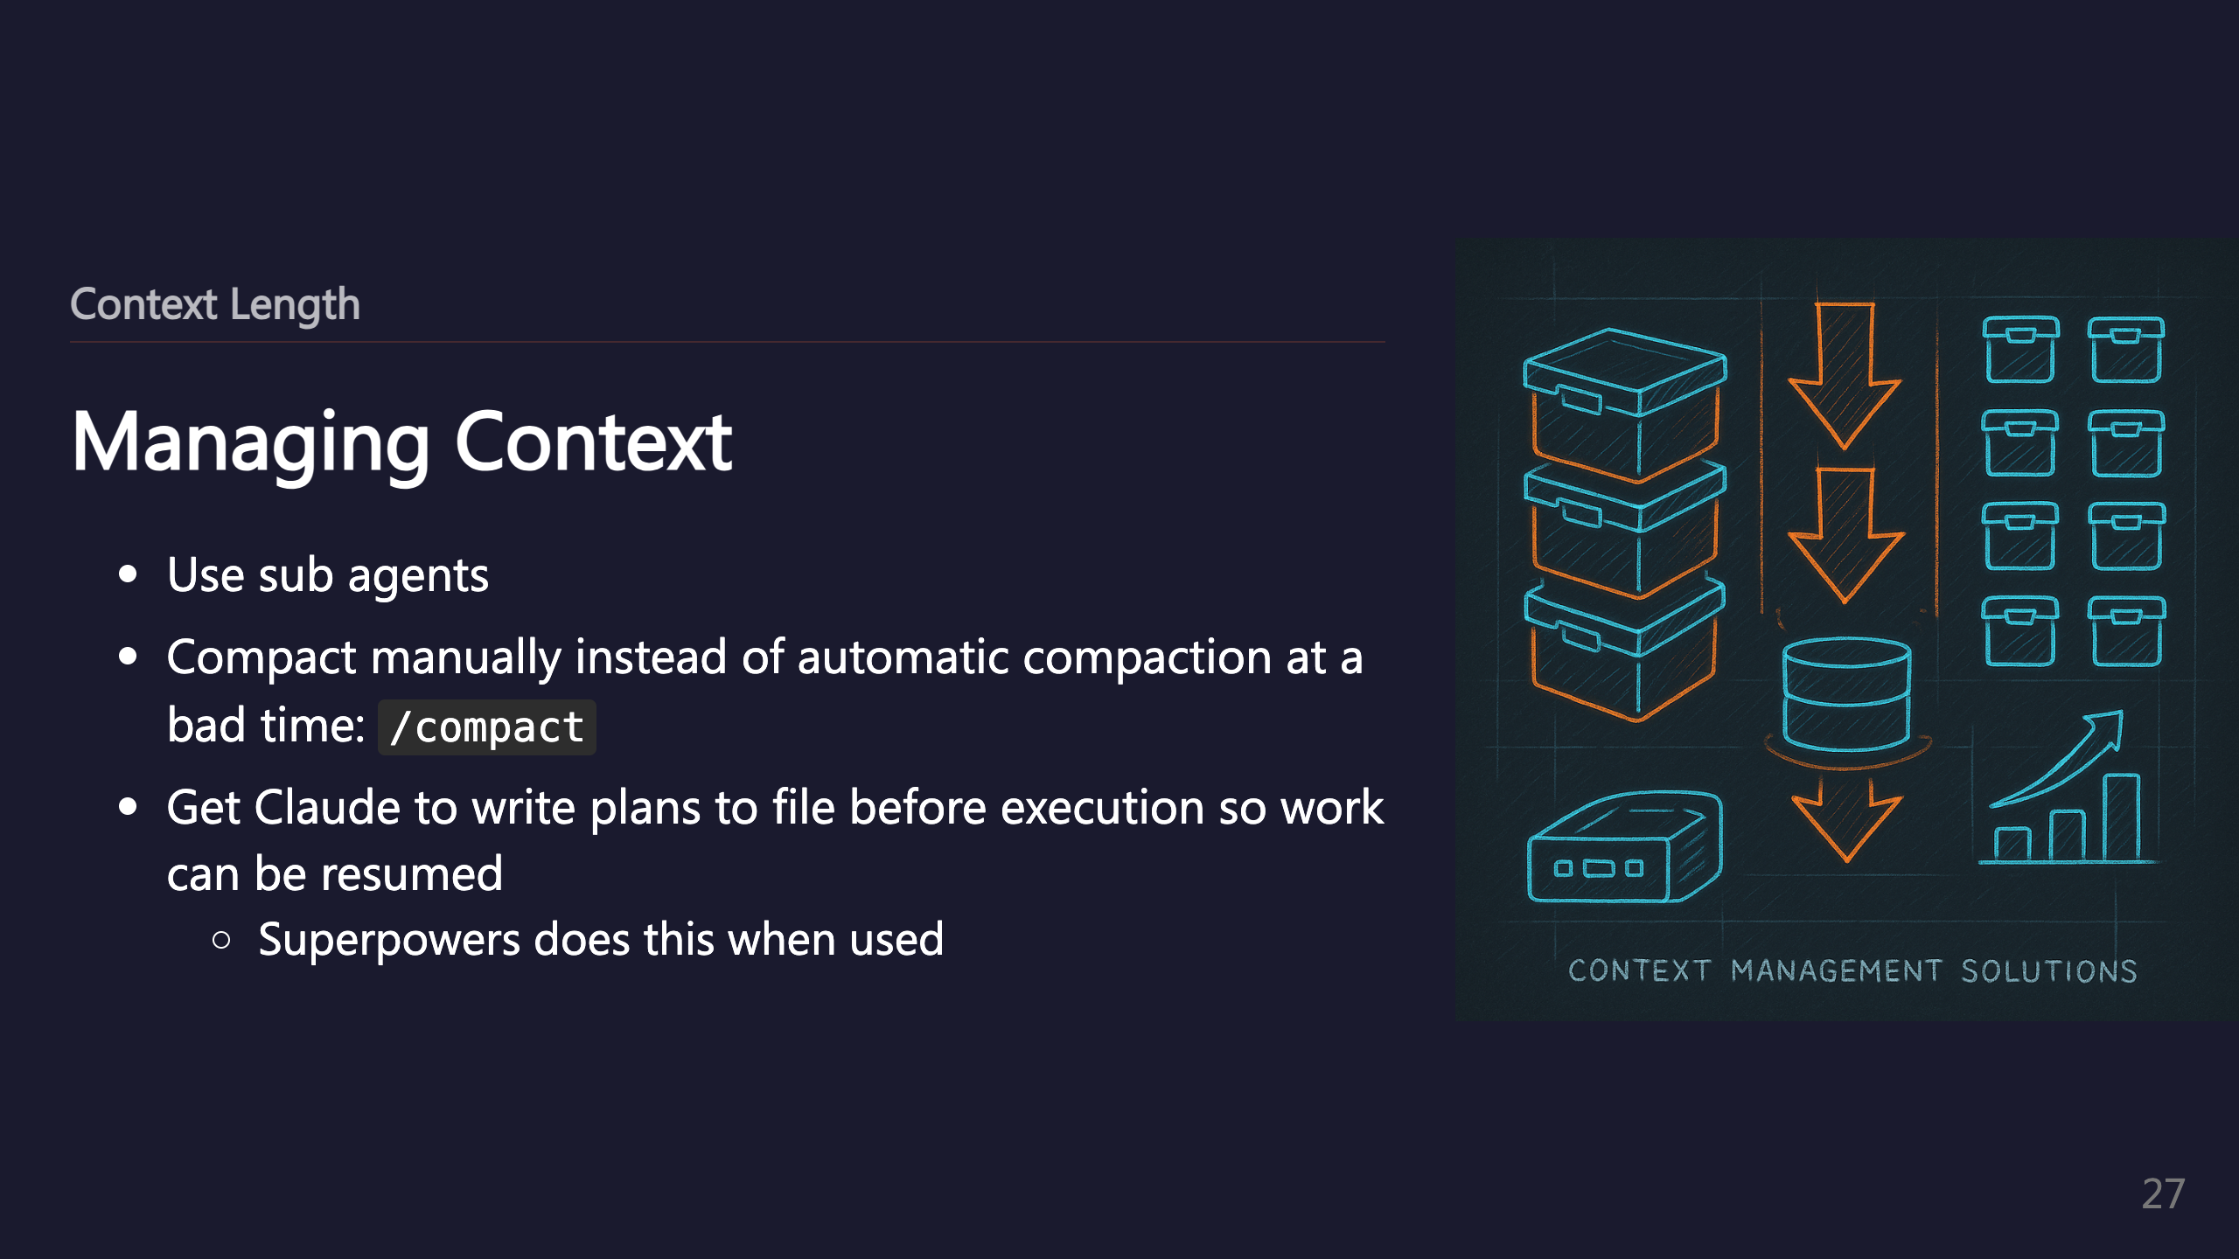

Slide 28
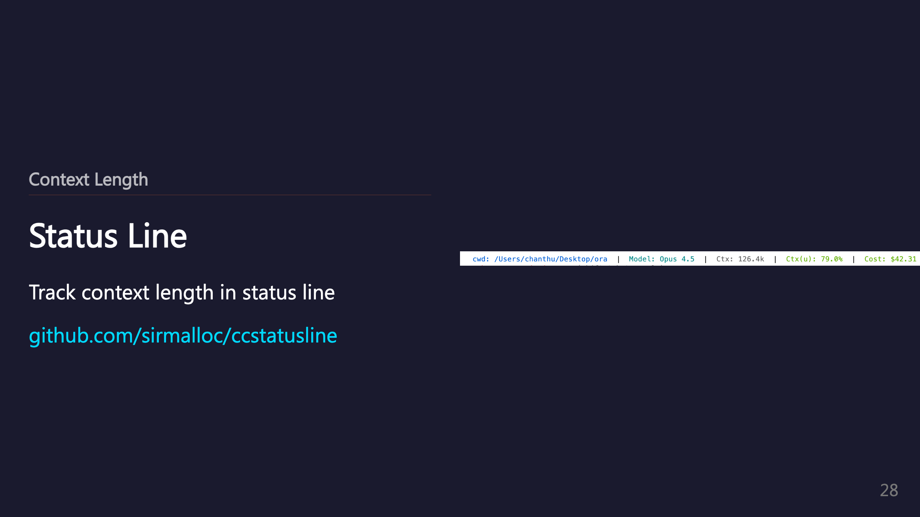
Notes:
_transition: push

Slide 29

Notes:
SECTION: Coming Soon

Slide 30


Slide 31


Slide 32


Slide 33


Slide 34


Slide 35


